Slide 1
Weekly report
Doan Manh Hung

Slide 2
Last Week
- Paper: Analysis of thin-walled closed beam with general quadrilateral cross section.

Slide 3
This week
- Stiffness matrix for rectangular cross section of thin walled beam.
- Distortion shape function for trapezoidal cross section
- Paper: Analysis of thin-walled closed beam with general quadrilateral cross section.

Slide 4

Shell displacements
$u_{n}\left(s,z\right)={{ψ_{n}}^{θ}}_{(s)}$.$θ_{(z)}+{{ψ_{n}}^{U}}_{(s)}$.$U_{(z)}+{{ψ_{n}}^{𝒳}}_{(s)}$.$𝒳_{(z)}$
$u_{s}\left(s,z\right)={{ψ_{s}}^{θ}}_{(s)}$.$θ_{(z)}+{{ψ_{s}}^{U}}_{(s)}$.$U_{(z)}+{{ψ_{s}}^{𝒳}}_{(s)}$.$𝒳_{(z)}$
$u_{z}\left(s,z\right)={{ψ_{z}}^{θ}}_{(s)}$.$θ_{(z)}+{{ψ_{z}}^{U}}_{(s)}$.$U_{(z)}+{{ψ_{z}}^{𝒳}}_{(s)}$.$𝒳_{(z)}$
y
n2
x
s1
s2
n1
n3
s3
t
s4
z
h
n4
b

Slide 5


Shape functions
${ψ_{n}}^{θ}$=-$s_{i}$(i=1,2,3,4)
${ψ_{s}}^{θ}$=$\left\{\begin{aligned}\frac{b}{2}(i=1,3) \\ \frac{h}{2}(i=2,4)\end{aligned}\right.$
${ψ_{z}}^{U}$=$\left\{\begin{aligned}\frac{b}{2}(i=1,3) \\ −\frac{h}{2}(i=2,4)\end{aligned}\right.$
${ψ_{n}}^{𝒳}$ =$\left\{\begin{aligned}−\frac{4}{h\left(b+h\right)}{s_{i}}^{3}+\frac{2b+h}{b+h}s_{i} (i=1,3) \\ \frac{4}{h\left(b+h\right)}{s_{i}}^{3}−\frac{2b+h}{b+h}s_{i} (i=2,4)\end{aligned}\right.$
${ψ_{s}}^{𝒳}$ =$\left\{\begin{aligned}\frac{bh}{b+h} (i=1,3) \\ −\frac{bh}{b+h} (i=2,4)\end{aligned}\right.$
$$θ$$
Rotation
Warping
Distorsion

Slide 6
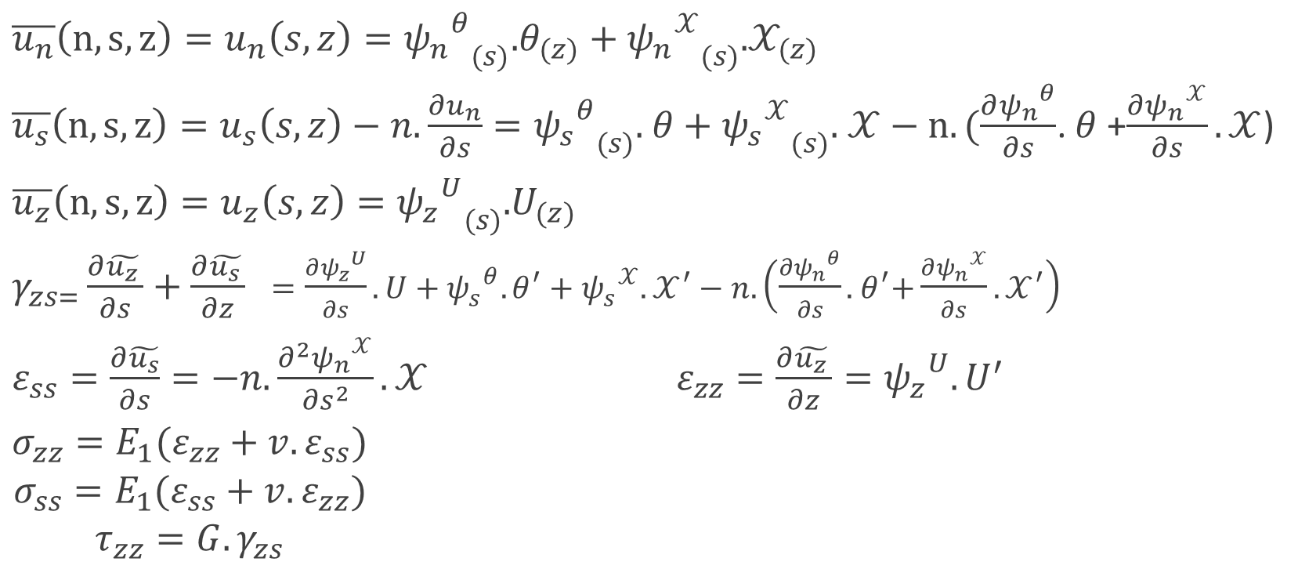
Displacement vectors - Stress, Strain
$\overline{u_{n}}\left(n,s,z\right)=u_{n}\left(s,z\right)={{ψ_{n}}^{θ}}_{(s)}$.$θ_{(z)}+{{ψ_{n}}^{𝒳}}_{(s)}$.$𝒳_{(z)}$
$\overline{u_{s}}\left(n,s,z\right)=u_{s}\left(s,z\right)−n.\frac{∂u_{n}}{∂s}={{ψ_{s}}^{θ}}_{(s)}$. $θ+{{ψ_{s}}^{𝒳}}_{(s)}$. $𝒳−n.(\frac{∂{ψ_{n}}^{θ}}{∂s}$. $θ$+$\frac{∂{ψ_{n}}^{𝒳}}{∂s}.𝒳$)
$ε_{ss}=\frac{∂\tilde{u_{s}}}{∂s}=−n.\frac{∂^{2}{ψ_{n}}^{𝒳}}{{∂s}^{2}}.𝒳 ε_{zz}=\frac{∂\tilde{u_{z }}}{∂z}={ψ_{z}}^{U}.U^{′}$
$\begin{aligned}σ_{zz}=E_{1}(ε_{zz}+v.ε_{ss}) \\ \begin{aligned}σ_{ss}=E_{1}(ε_{ss}+v.ε_{zz}) \\ τ_{zz}=G.γ_{zs}\end{aligned}\end{aligned}$

Slide 7
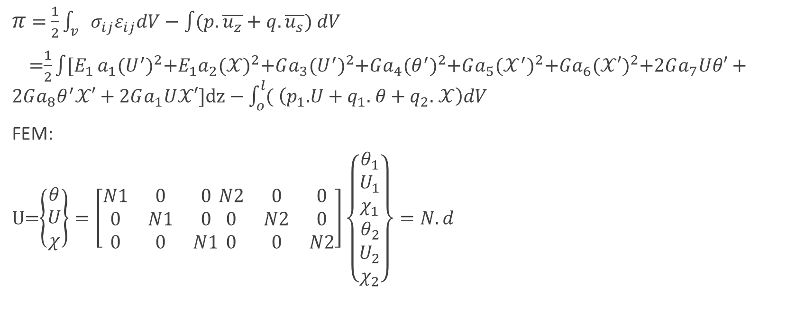
Minimum potential energy
$π$ = $\frac{1}{2}\int_{v}{{σ_{ij}ε}_{ij}dV−\int{(p.\overline{u_{z}}+q.\overline{u_{s}}) dV}}$
=$\frac{1}{2}\int{[E_{1}}a_{1}{(U^{′})}^{2}+E_{1}a_{2}{(𝒳)}^{2}$+$Ga_{3}{(U^{′})}^{2}+Ga_{4}{(θ^{′})}^{2}+Ga_{5}{(𝒳^{′})}^{2}+Ga_{6}{(𝒳′)}^{2}+2Ga_{7}Uθ′+2Ga_{8}θ^{′}𝒳′$ + $2Ga_{1}U𝒳′]dz−\int_{o}^{l}{(}$ $\left(p_{1}\text{.}U+q_{1}\text{.} θ+q_{2}\text{.} 𝒳\right)dV$
FEM:
U=$\left\{\begin{aligned}θ \\ U \\ χ\end{aligned}\right\}=\left[\begin{matrix}N1 & 0 & 0 \\ 0 & N1 & 0 \\ 0 & 0 & N1\end{matrix}\begin{matrix}N2 & 0 & 0 \\ 0 & N2 & 0 \\ 0 & 0 & N2\end{matrix}\right]\left\{\begin{aligned}θ_{1} \\ U_{1} \\ χ_{1} \\ \begin{aligned}θ_{2} \\ U_{2} \\ χ_{2}\end{aligned}\end{aligned}\right\}=N.d$

Slide 8
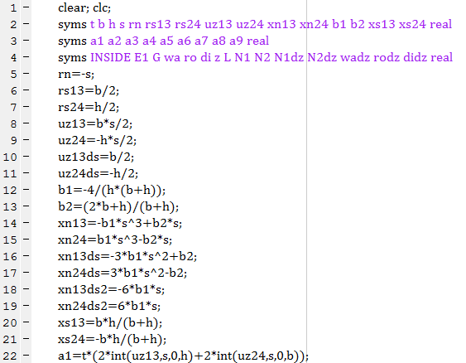
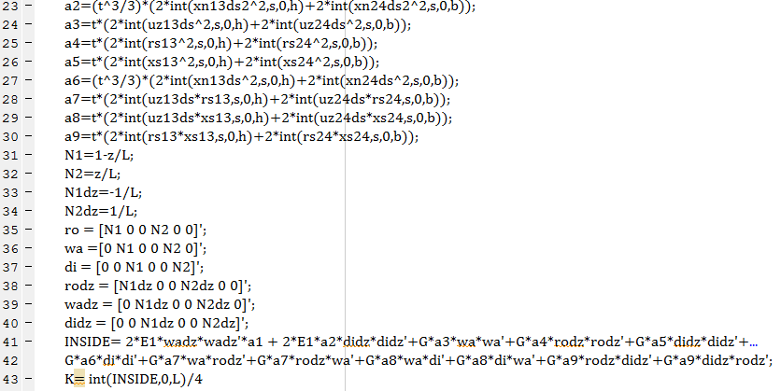

Slide 9
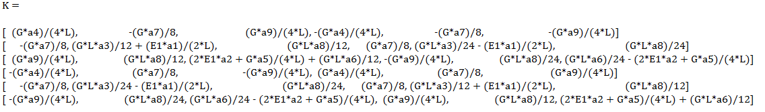
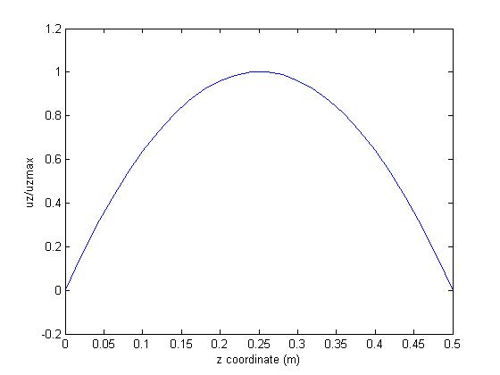

Slide 10
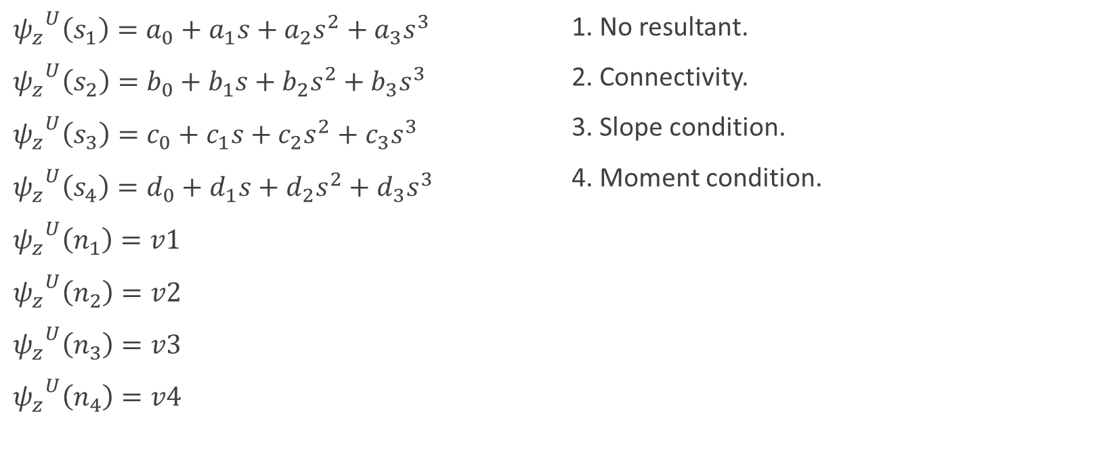
Trapezoidal shape functions
${ψ_{z}}^{U}\left(s_{1}\right)={a_{0}+a_{1}s+a}_{2}s^{2}+a_{3}s^{3}$
${ψ_{z}}^{U}\left(s_{2}\right)={b_{0}+b_{1}s+b}_{2}s^{2}+b_{3}s^{3}$
${ψ_{z}}^{U}\left(s_{3}\right)={c_{0}+c_{1}s+c}_{2}s^{2}+c_{3}s^{3}$
${ψ_{z}}^{U}\left(s_{4}\right)={d_{0}+d_{1}s+d}_{2}s^{2}+d_{3}s^{3}$
${ψ_{z}}^{U}\left(n_{1}\right)=v1$
${ψ_{z}}^{U}\left(n_{2}\right)=v2$
${ψ_{z}}^{U}\left(n_{3}\right)=v3$
${ψ_{z}}^{U}\left(n_{4}\right)=v4$
1. No resultant.
2. Connectivity.
3. Slope condition.
4. Moment condition.
a
α
h
b

Slide 11
Equation
(a+b).v1/4+v2.a/2+(a+b).v3/4+v4.b/2=0
h.cosa.v1/sina+a.v2-h.v3.cosa/sina-b.v4=0
v1+v3=0
a0+h.a1/(2sina)+a2.h^2/(4sina^2)+a3.h^3/(8sina^3)=-v2
b0-a.b1/2+b2.a^2/4-b3.a^3/8=v1
b0+b1.a/2+b2.a^2/4+b3.a^3/8=-v3
c0-c1.h/(2sina)+c2.h^2/(4sina^2)-c3.h^3/(8sina^3)=v2
c0+c1.h/(2sina)+c2.h^2/(4sina^2)+c3.h^3/(8sina^3)=-v4
d0-d1.b/2+d2.b^2/4-d3.b^3/8=v3
d0+d1.b/2+d2.b^2/4+d3.b^3/8=-v1
a0-h.a1/(2sina)+a2.h^2/(4sina^2)-a3.h^3/(8sina^3)=v4
a1+a2.h/(sina)+a3.(3/4).h^2/sina^2-b1+a.b2-b3.(3/4).a^2=0
b1+b2.a+b3.(3/4).a^2-c1+c2.h/(sina)–c3.(3/4).h^2/sina^2=0
c1+c2.h/(sina)+c3.(3/4)h^2/sina^2-d1+d2.b–d3.(3/4).b^2=0
-a1+a2.h/(sina)-a3.(3/4)h^2/sina^+d1+d2.b+d3.(3/4).b^2=0
2.a2+a3.3.h/sina-2.b2+3.b3.a=0
2.b2+3.b3.a-2c2+3.h/sina=0
2.c2+3.c3.h/sina-2.d2+3d3.b=0
-2a2+a3.3.h/sina+2d2+3.d3.b=0
v1=1

Slide 12
Distortion shape functions
a0= (cosa*h*(4*a^2*b*sina^2 + 11*a^2*h*sina + 4*a*b^2*sina^2 + 10*a*b*h*sina + 12*a*h^2 + 11*b^2*h*sina + 12*b*h^2))/(8*a*b*sina*(3*h^2 + *a*h*sina + 2*b*h*sina + a*b*sina^2))
a1=-(cosa*(a - b)*(18*h^2 + 9*a*h*sina + 9*b*h*sina + 4*a*b*sina^2))/(4*a*b*(3*h^2 + 2*a*h*sina + 2*b*h*sina + a*b*sina^2))
a2=-(3*cosa*sina^2*(a - b)^2)/(2*a*b*(3*h^2 + 2*a*h*sina + 2*b*h*sina + a*b*sina^2))
a3=(cosa*sina^2*(a - b)*(6*h + a*sina + b*sina))/(a*b*h*(3*h^2 + 2*a*h*sina + 2*b*h*sina + a*b*sina^2))
b0=1
b1=(cosa*sina*(3*h + b*sina)*(a - b))/(2*b*(3*h^2 + 2*a*h*sina + 2*b*h*sina + a*b*sina^2))
b2=0
b3=-(2*cosa*sina*(3*h + b*sina)*(a - b))/(a^2*b*(3*h^2 + 2*a*h*sina + 2*b*h*sina + a*b*sina^2))
c0=-(cosa*h*(4*a^2*b*sina^2 + 11*a^2*h*sina + 4*a*b^2*sina^2 + 10*a*b*h*sina + 12*a*h^2 + 11*b^2*h*sina + 12*b*h^2))/(8*a*b*sina*(3*h^2 + 2*a*h*sina + 2*b*h*sina + a*b*sina^2))
c1=-(cosa*(a - b)*(18*h^2 + 9*a*h*sina + 9*b*h*sina + 4*a*b*sina^2))/(4*a*b*(3*h^2 + 2*a*h*sina + 2*b*h*sina + a*b*sina^2))
c2=(3*cosa*sina^2*(a - b)^2)/(2*a*b*(3*h^2 + 2*a*h*sina + 2*b*h*sina + a*b*sina^2))
c3=(cosa*sina^2*(a - b)*(6*h + a*sina + b*sina))/(a*b*h*(3*h^2 + 2*a*h*sina + 2*b*h*sina + a*b*sina^2))
d0=-1
d1=(cosa*sina*(3*h + a*sina)*(a - b))/(2*a*(3*h^2 + 2*a*h*sina + 2*b*h*sina + a*b*sina^2))
d2=0
d3=-(2*cosa*sina*(3*h + a*sina)*(a - b))/(a*b^2*(3*h^2 + 2*a*h*sina + 2*b*h*sina + a*b*sina^2))
17) v1=1 18)v2=-(cosa*h)/(a*sina) 19) v3=-1 20) v4=(cosa*h)/(b*sina)

Slide 13
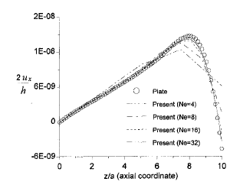
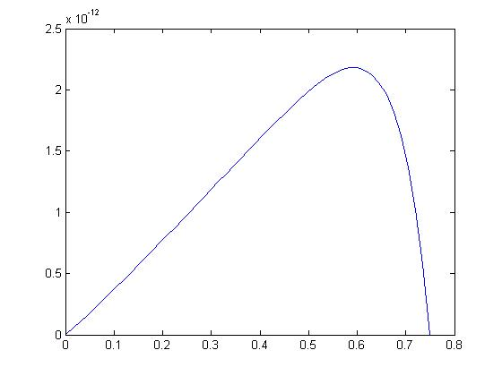

Slide 14
v1=1
v2=-(cosa*h)/(a*sina)
v3=-1
v4=(cosa*h)/(b*sina)

Slide 15
Next week

